Slide 1
Spreading With
Edge Weights
Spreading in the main branch!

Slide 2
Quick SMem Activation Recap
Activation is a number that ranks Semantic Memory elements (LTIs)
When your agent issues a query to SMem, the result is the LTI which matches and also has the highest activation value.
Base-Level and Spreading activation both contribute to the total activation value.
Spreading activation ranks SMem cue-matched results higher if they are more closely connected to working memory instances of LTIs.
1

Slide 3
Spreading Activation Example
Working Memory
L49 (@75)
orange
L58 (@11)
watermelon
L63 (@48)
grape
L44 (@52)
apple
L35 (@10)
banana
smem -q {(<cue> ^name <any>)}
(@41 ^name edible_fruit ^[...])
(Thanks WordNet!)
2

Slide 4
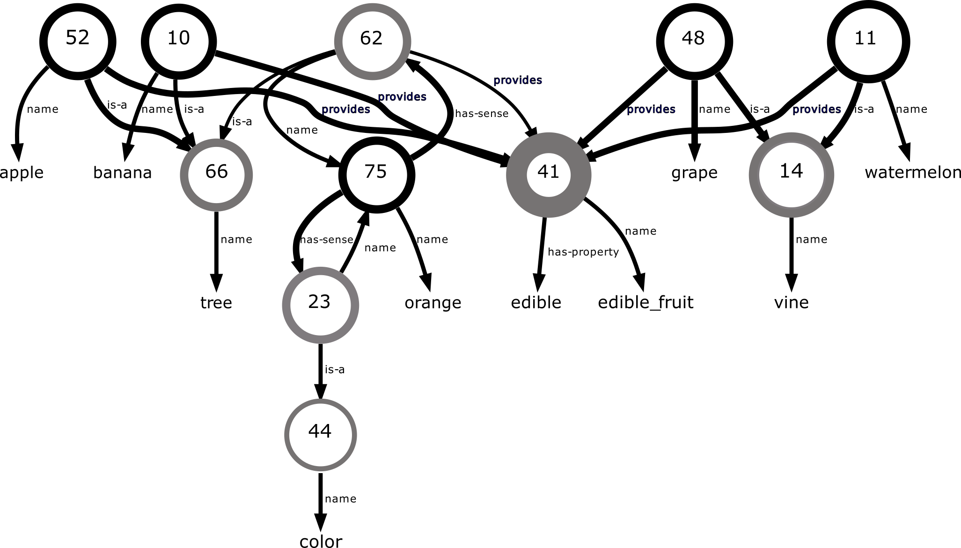
Spreading Activation Example
3

Slide 5
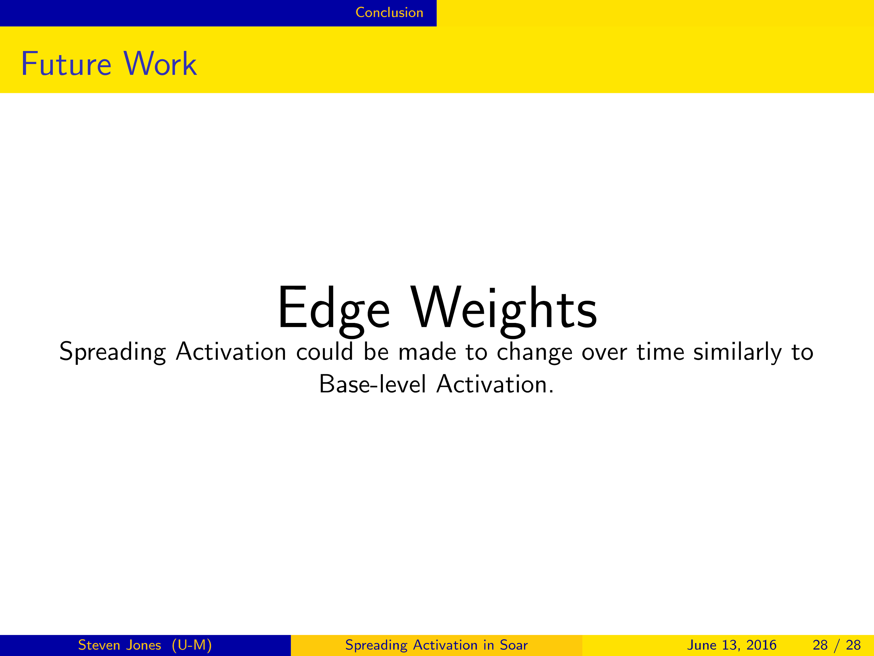
Edge Weights?
4

Slide 6
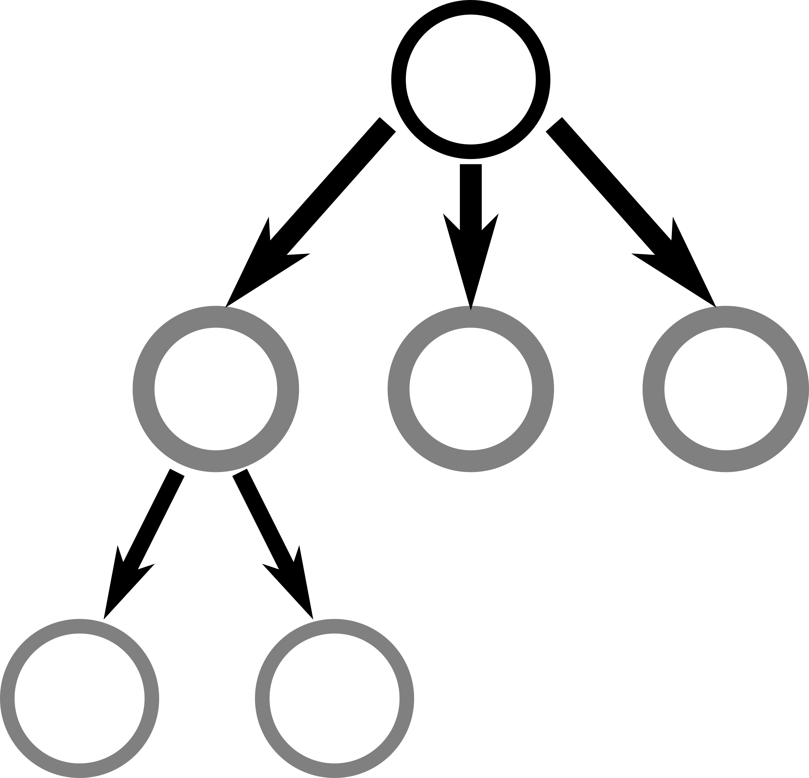
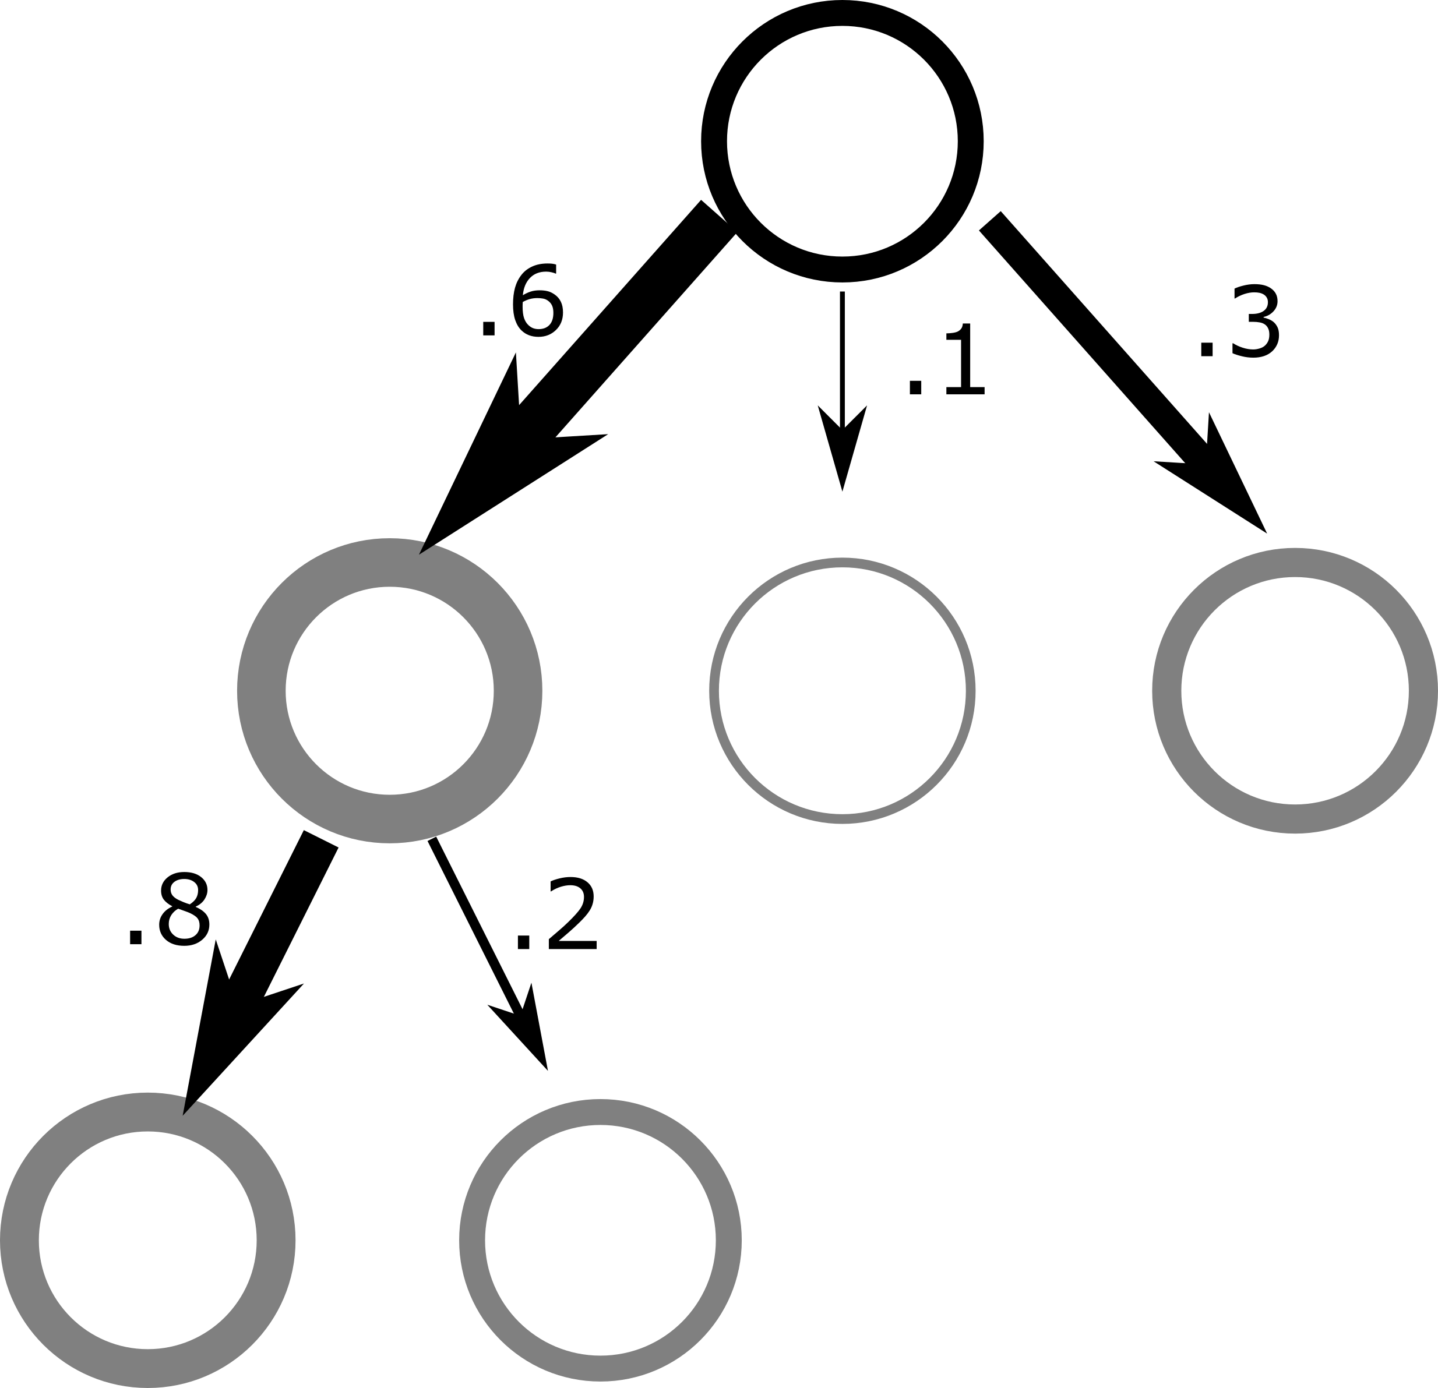
Edge Weights Toy Example
Old, Uniform Spread
Spread with weights!
5

Slide 7
Usage
6

Slide 8
Usage
Manual
For agents with SMem networks containing edge metadata:
smem -a {(<node1> ^connection <node2> (weight))}
For real working example, see next talk!
6

Slide 9
Usage
Updating (learning weights)
How to boost edge weights?
7

Slide 10
Usage
Updating
How to boost edge weights?
Need a measure of “importance” for edges of LTIs instantiated into Working Memory
7

Slide 11
Usage
Updating
Experimental heuristic
Boosts to WMA for LTIi-LTIi edges in WMEM increases weights for those edges in SMEM
7

Slide 12
Usage
Updating
Experimental heuristic
Boosts to WMA for LTIi-LTIi edges in WMEM increases weights for those edges in SMEM
wma --set activation on
smem --set spreading-edge-updating on
7

Slide 13
Edge Weights Test Agent
Can I make interesting behavior using weights?
8

Slide 14
Edge Weights Test Agent
SMem:
Agent has 26 LTIs in SMem, all fully-connected to each other.
Each LTI also contains a string value
“A”, “B”, “C”, ... , “Z”
9

Slide 15
Edge Weights Test Agent
SMem:
Agent has 26 LTIs in SMem, all fully-connected to each other.
Each LTI also contains a string value
“A”, “B”, “C”, ... , “Z”
Goal:
Train agent to automatically recall alphabet in order.
9

Slide 16
Edge Weights Test Agent
Training:
Force recall in order
(hand-written cue-based retrieval rules)
Cue: ^letter B
WMEM Result: L75 (@2) ^letter B ^next L97 (@1) ^next L98 (@2) ^next L99 (@3) ^next L100 (@4) ...
10

Slide 17
Edge Weights Test Agent
Training:
Force recall in order
Connect current letter to previous*
WMEM:old a->b edge, new b
sp {apply*link-previous-to-current
(state <s> ^operator.name link-previous-to-current
^previous-letter-lti <previous-lti>
^current-letter-lti <current-lti>)
(<previous-lti> ^next {@ <current-lti> <prev-child>})
...
10

Slide 18
Edge Weights Test Agent
Training:
Force recall in order
Connect current letter to previous
WMEM:new a->b edge, new b
-->
(<previous-ltii> ^next <current-ltii>)
(<previous-ltii> ^next <prev-child> -)
}
10

Slide 19
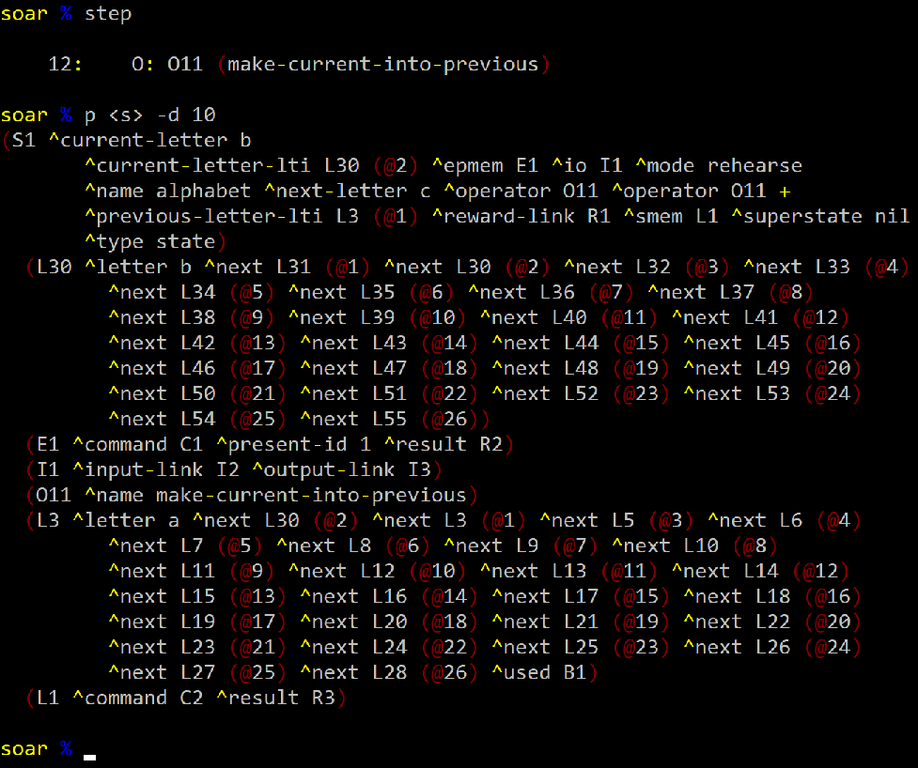
Edge Weights Test Agent
Training:
11

Slide 20
Edge Weights Test Agent
Test:
Start with forced retrieval of A
Cue: ^letter A
12

Slide 21
Edge Weights Test Agent
Test:
Start with forced retrieval of A
Cue: ^letter A
Freely recall additional letters
Cue: ^letter <var>
12

Slide 22
Results?
13

Slide 23
Results?
It worked!
13

Slide 24
Results?
It worked!
(But that’s cheating, I kept at it until it worked.)
13

Slide 25
Real Results
What changes were necessary to make test agent work?
14

Slide 26
Real Results
What changes were necessary to make test agent work?
Base-level inhibition
“Fixes” free recall loops without requiring prohibition of all previous letters.
Ex: Recall “A” after “A” just because “A” was recently boosted
14

Slide 27
Real Results
What changes were necessary to make test agent work?
Base-level inhibition
“Fixes” free recall loops without requiring prohibition of all previous letters.
Ex: Recall “A” after “A” just because “A” was recently boosted
Distractor period
Agent issues retrievals for unrelated dummy LTI between training and test
Reduces recency impact of BLA in test
14

Slide 28
Real Results
What changes were necessary to make test agent work?
Base-level inhibition
“Fixes” free recall loops without requiring prohibition of all previous letters.
Ex: Recall “A” after “A” just because “A” was recently boosted
Distractor period
Agent issues retrievals for unrelated dummy LTI between training and test
Reduces recency impact of BLA in test
Multiple (8) rehearsals
Makes additional BLA changes small in comparison, increases edge weight changes
14

Slide 29
Real Results
Activation dynamics matter!
15

Slide 30
Does this slow Soar down?
Only if you use SMem,
but especially if you use spreading activation.
*neither of these configurations can exhibit the intended retrieval behavior using only SMem activation. They serve only as timing comparisons.
Alphabet Agent SMem Timing (ms) | 9.6 before spread pull request* | 9.6 with spread off and edge weight updating off* | 9.6 with spread on and edge weight updating off** | 9.6 with spreading and edge weight updating on
Training Phase (1396 DCs) (208 queries) | 47.2 | 50.3 | 53.8 | 52.9
Test Phase (1 “hard” query) | 2.0 | 2.3 | 2.4 | 2.7
16

Slide 31
Does this slow Soar down?
What if you don’t use SMem?
A performance testing suite for 15 agents that don’t use SMem.
(It’s for Mazin’s chunking work.)
17

Slide 32
Does this slow Soar down?
What if you don’t use SMem?
A performance testing suite for 15 agents that don’t use SMem.
(It’s for Mazin’s chunking work.)
118s for the suite before
…???
17

Slide 33
Does this slow Soar down?
What if you don’t use SMem?
A performance testing suite for 15 agents that don’t use SMem.
(It’s for Mazin’s chunking work.)
118s for the suite before
118s for the suite after
17

Slide 34
Nuggets and Coal
Nuggets:
Spreading Activation is actually in Soar
It offers additional SMem functionality
It doesn’t slow the rest of Soar down
Larger space of SMem design choices and parameters
Coal:
SMem is slightly slower even without spread on
Database indexing and schema changes?
Spreading is slower than in earlier test versions.
Edge weights prevent certain optimizations
Update mechanism is largely heuristic
Large space of SMem design choices and parameters
18

